Slide 1

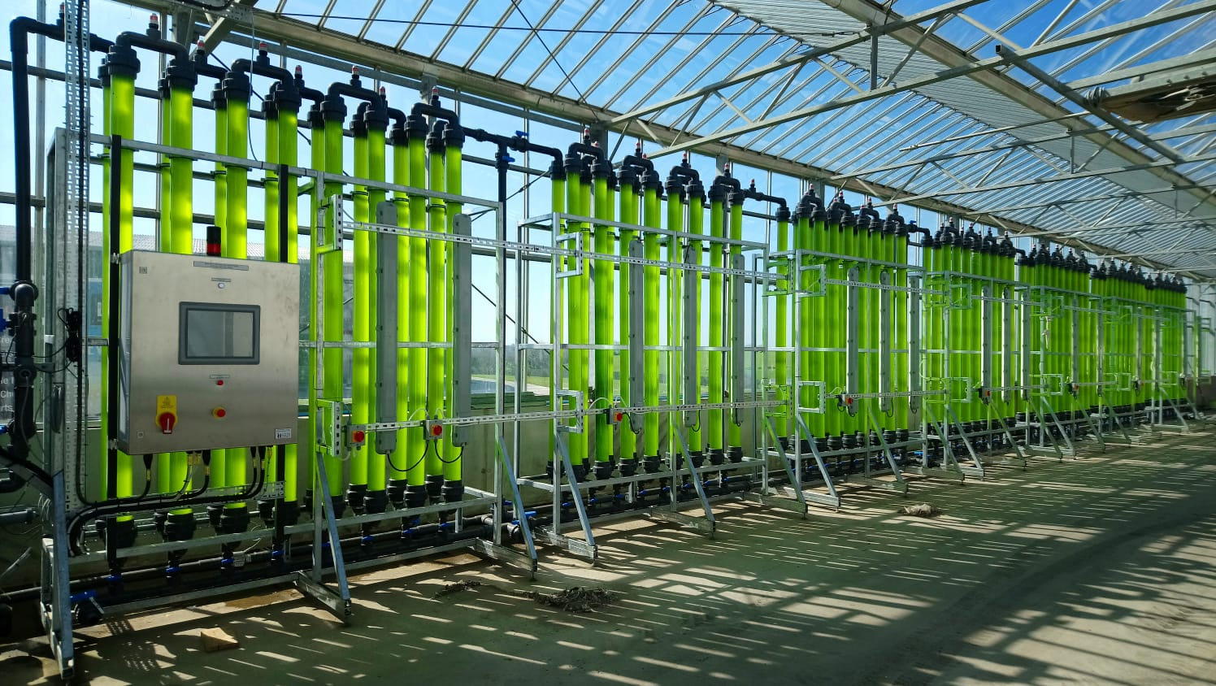
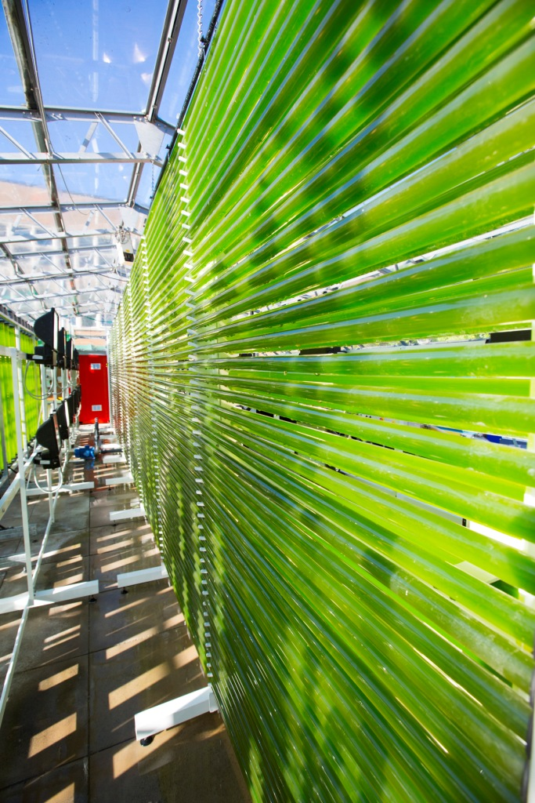
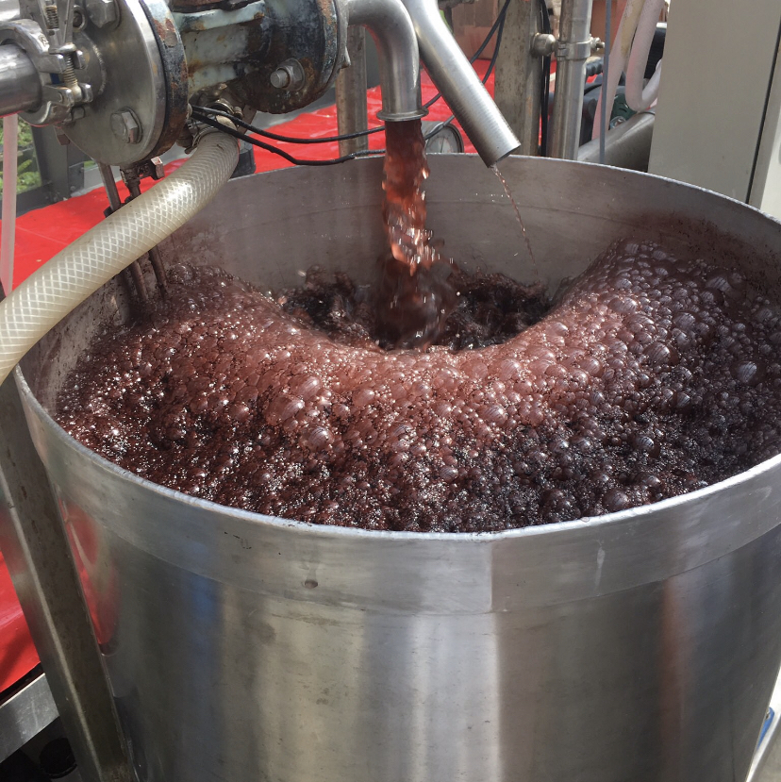
STRATEGIES OF ALGAL BIOTECHNOLOGY FOR THE GREEN INITIATIVES
Dr Alla Silkina,
BIOSCIENCE DEPARTMENT
SWANSEA UNIVERSITY,UK
a.silkina@swansea.ac.uk

Slide 2

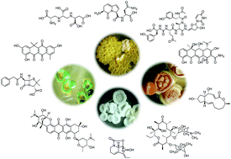
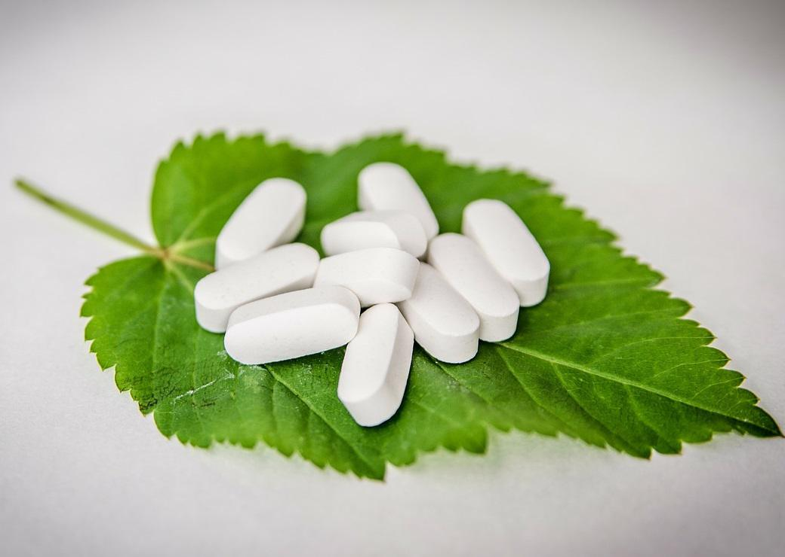
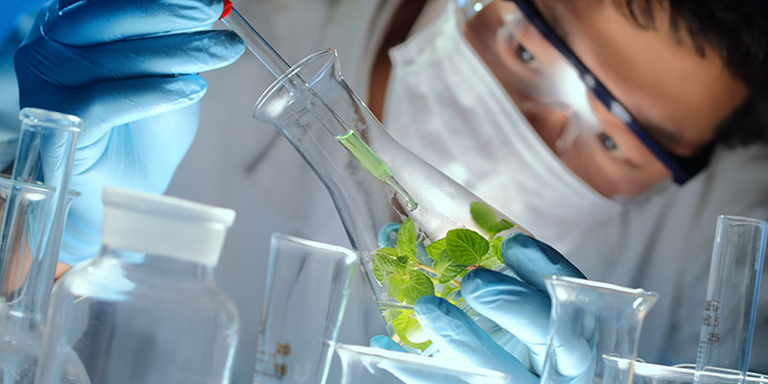

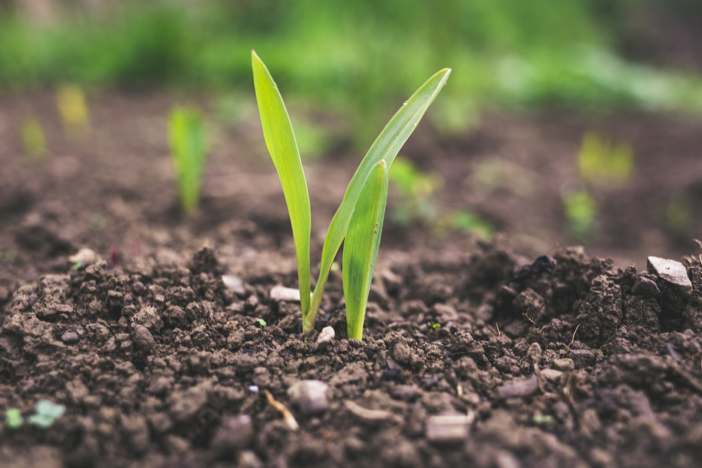
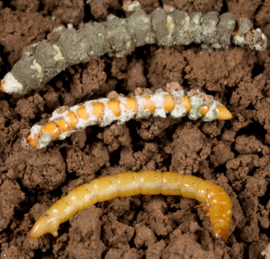
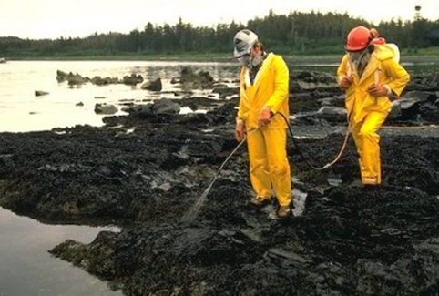
Natural Products: Huge Demand & Potential
The application of living organisms or compounds extracted from living organisms
From: RSC
From: Uni of Bordeaux
From: Uni of York
Food additives
Anti-microbials
Pharmaceuticals
Industrial enzymes
From: Healthline.com
From: Medinbio
Cosmetics & nutrition
Soil health & plant growth
Pest & disease control
Bioremediation
Notes:
Vast Industrial potential & securing UK leadership

Slide 3
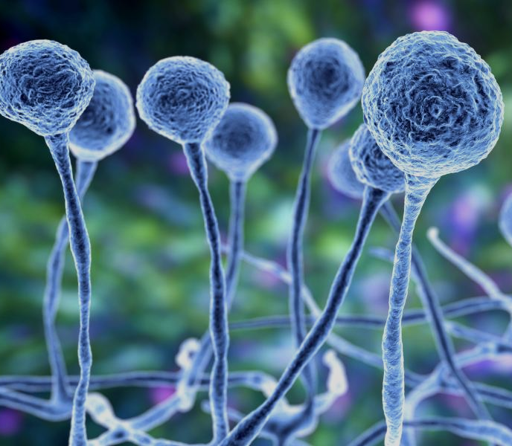
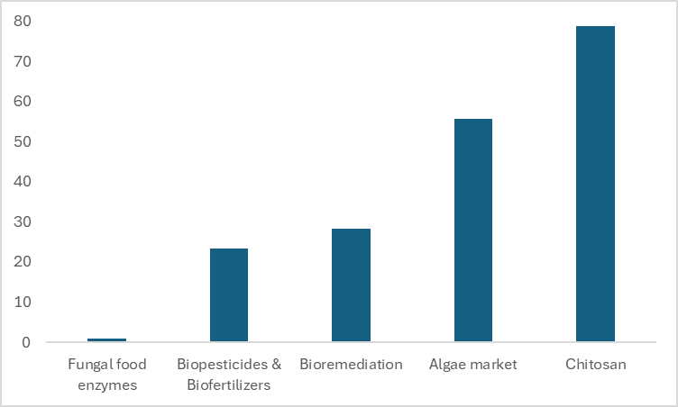
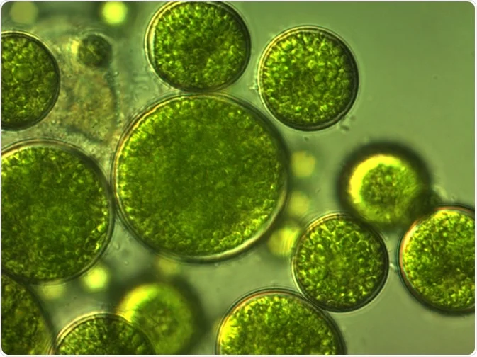
UK Centre: Green Biotech Market Opportunity & Demand
Vast Industrial potential & securing UK leadership
Predicted Market Value 2030
$78.9bn
$55.7bn
$28.3bn
$23.3bn
$0.8bn
Fungal food enzymes
Biopesticides & biofertilizers
Bio-
remediation
Algal market
Chitosan

Slide 4
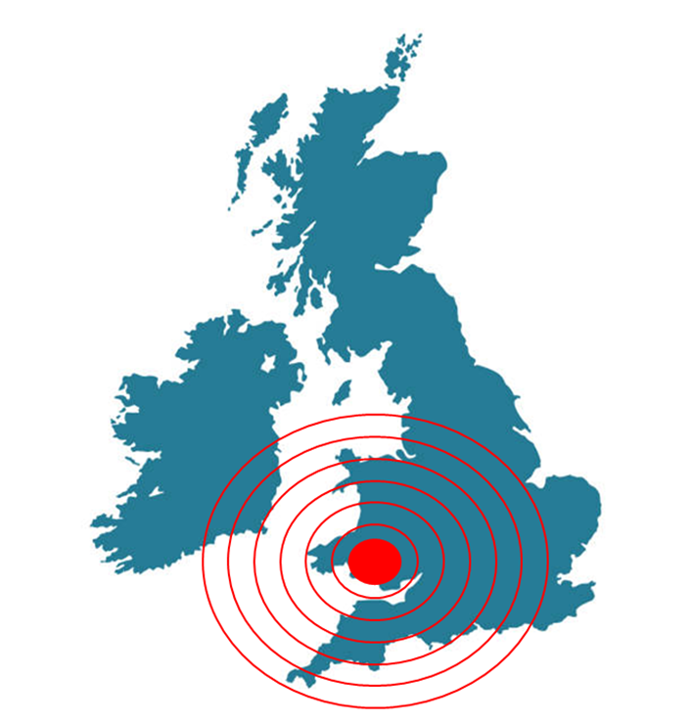




Regional Focus: South Wales Gateway for Green Biotech Economies
NP BioHUB - launched 2022
Shared prosperity Fund
Community-driven
Biophilic Living, biodiversity & NetZero
Green jobs & investment
SU
Algae
Fungi

Slide 5

Microalgal contribution to Circular Bioeconomy
LED and
other alternative lights
Solar energy
HARVESTING Valuable biomass
Rich on omega oils, proteins and pigments
WASTE HEAT
Algal Culture
H2O + CO2 = (H2CO)n + O2
Production of algal biomass
Water:
Freshwater
Brackish water
Sea water – water recycling
CARBON STORAGE
WASTE CO₂
_{Flue gas}
OXYGEN PRODUCTION
Air quality improvement
N2
Nitrogen fixation
WASTE STREAMS Nutrients
Notes:
One of the most important task of microalgae biotechnology is their cultivation. For this purpose

Slide 6
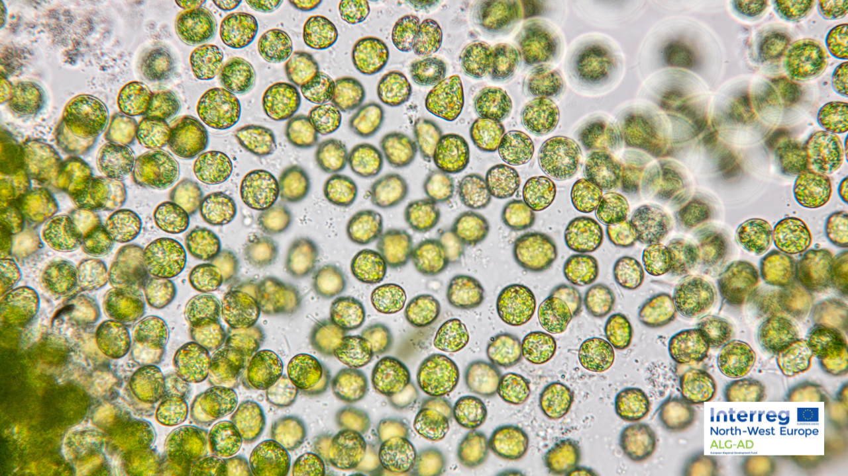
Microalgal biomass use
High value Chemical compounds
Pigments
Fatty acids
Extraction of specific cell compounds
ENERGY
Oil , methane, H2
ALGAL BIOMASS
Agrichemicals : Biofertilisers
Biostimulants
Aquaculture
Treated clean water
Clean air
Food / Feed development
Notes:
Microalgae can serve

Slide 7
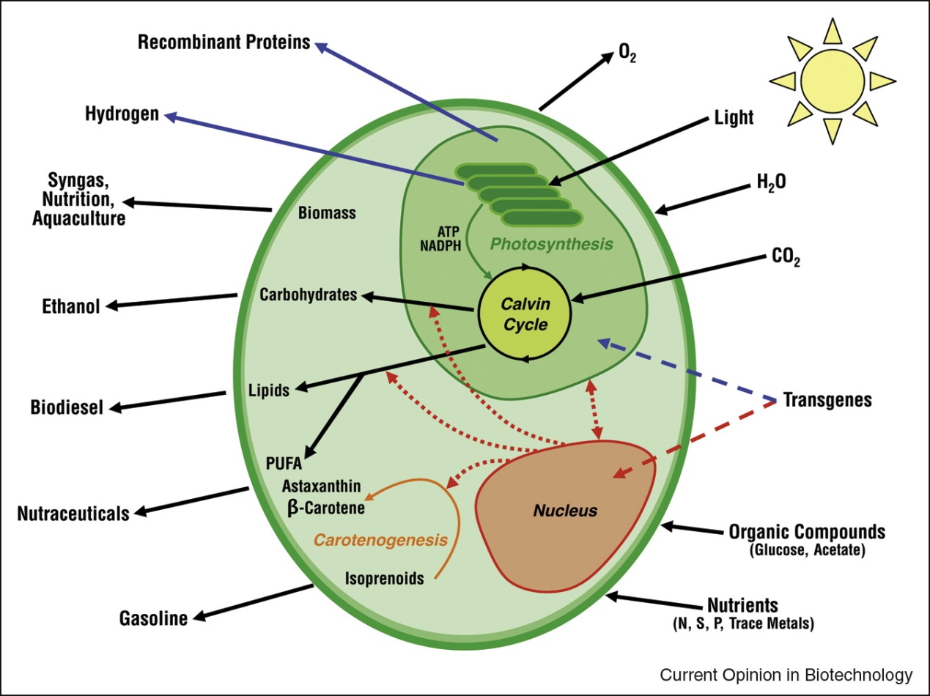
What is Algal Biotechnology?
Algal biotechnology refers to the use of algae for sustainable production and environmental applications,
High biomass production
Microalgae can synthesize 30 times more oil than terrestrial plants
Oil level 20-50%
High growth rate
CO2 uptake for growth

Slide 8




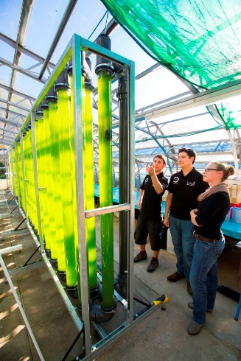
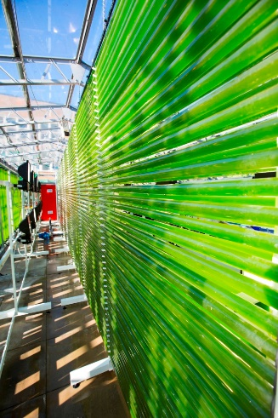
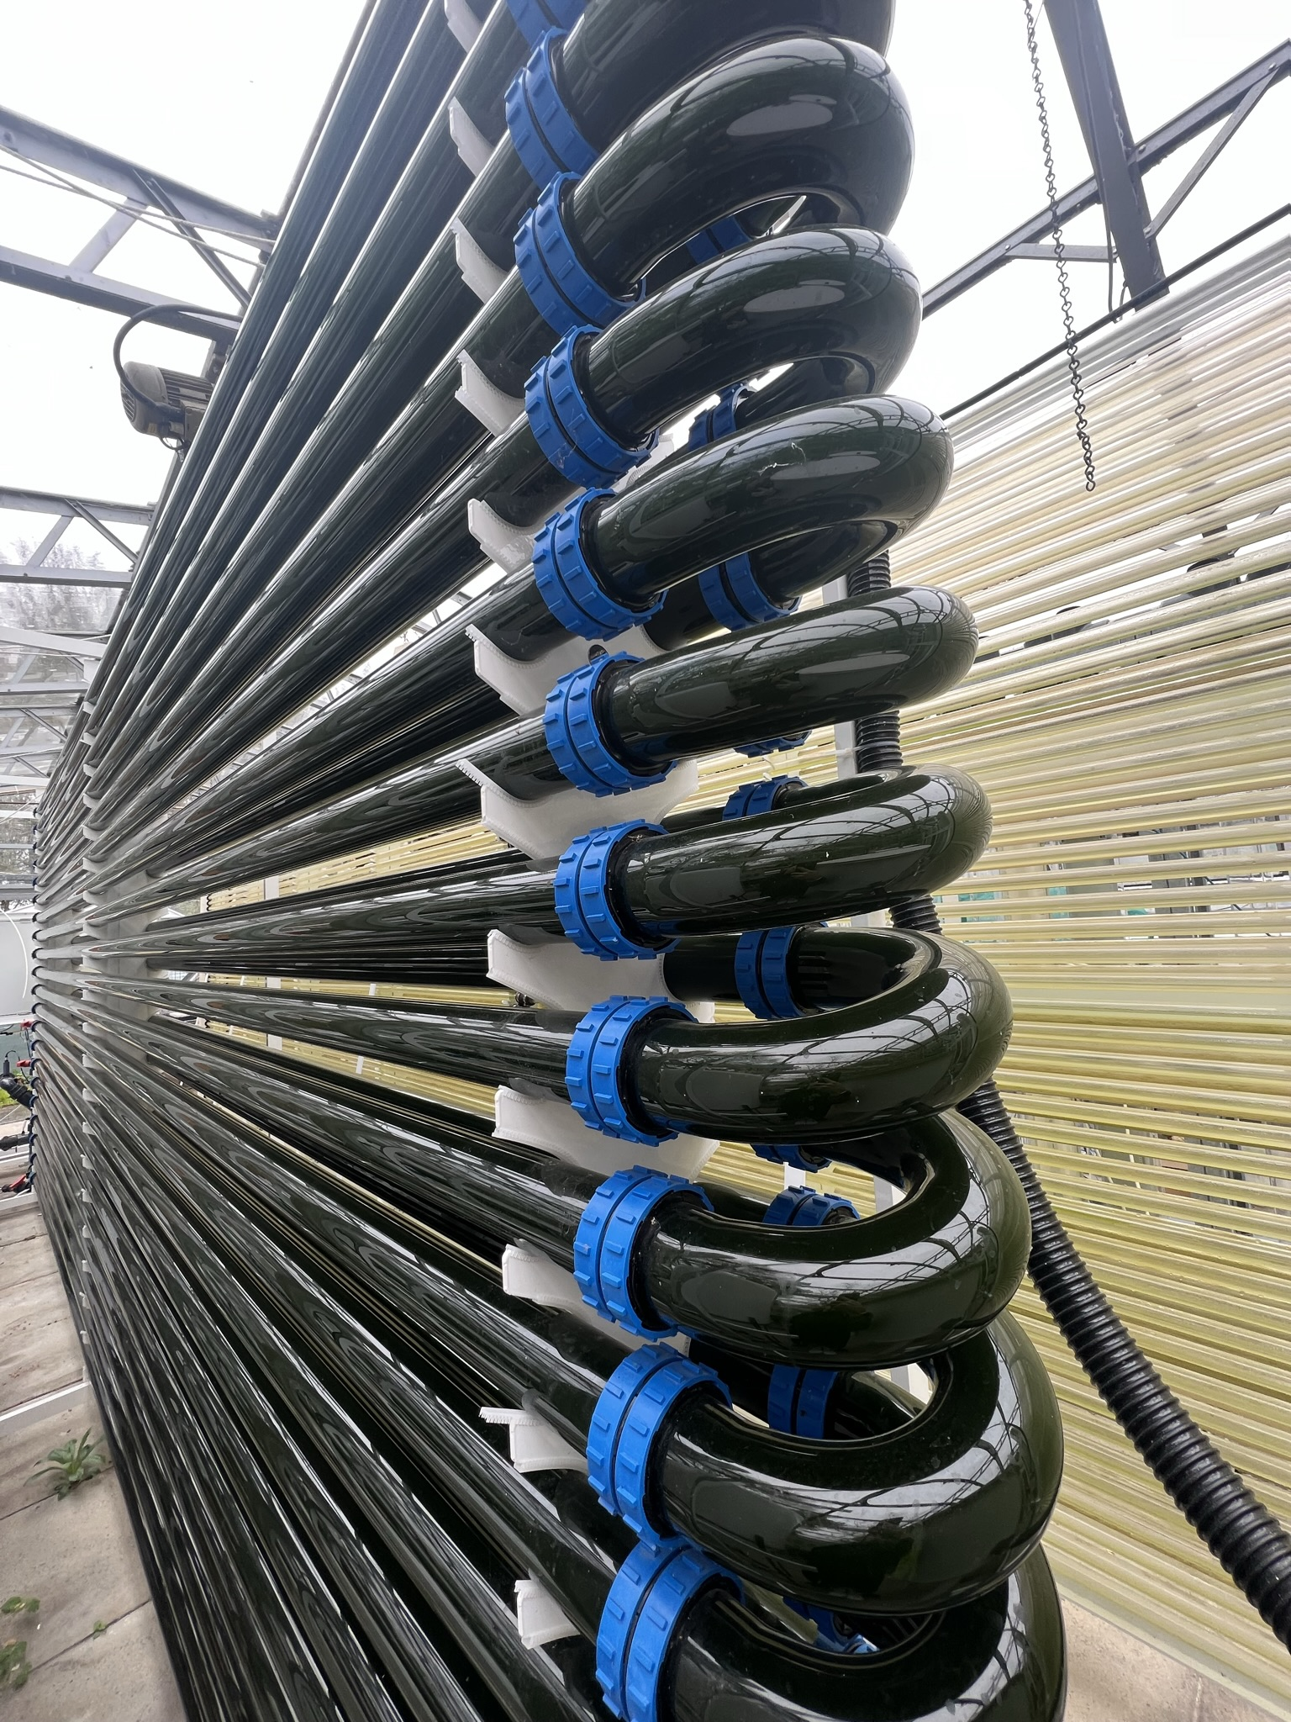
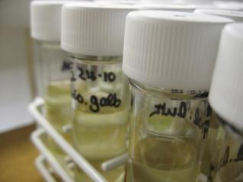
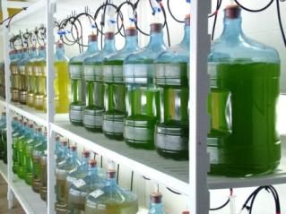
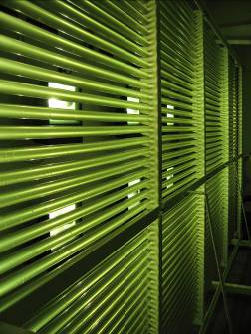
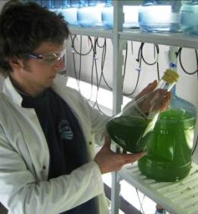
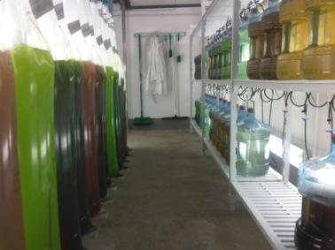
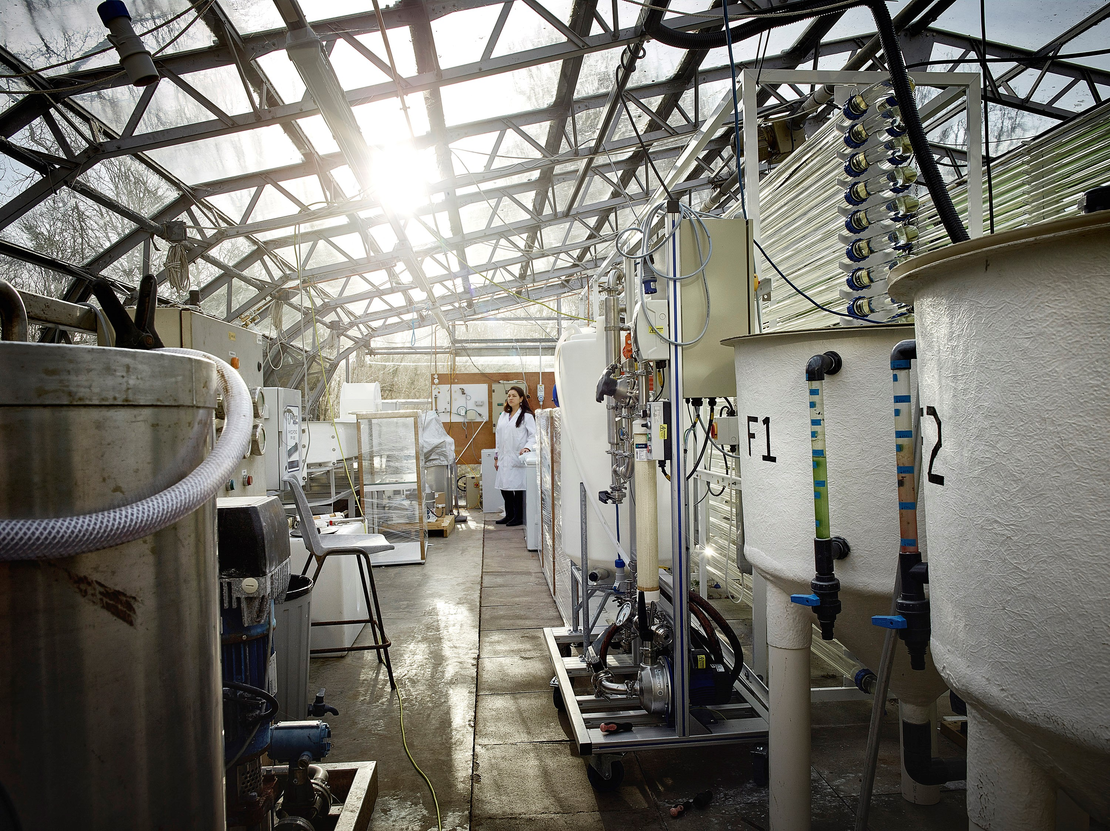

Swansea University facility
  ● Algal collections ~ 30 species for mass cultivation (Sterile cultures 20ml → 2L → 20L Carboys)
  ● 20 x 100L batch culture capacity, controlled environment lab
  ● 2 x 800L Biofences, greenhouse
  ● 1 x 1,000L Phyco-Flow glass PBR,
  ● 1 x 2,000L PBR, greenhouse
  ● 1 x 4,000L vertical PBR, form industrial location
  ● 3 x 1,000L Phycoponds
  ● Pilot dewatering facilities membrane filtration: MF, UF, DF
  ● Continues flow-centrifuge 200 L/hours
  ● Industrial freeze dryer /Spray drier
  ● Homogeniser and bead mill

Slide 9














Microalgal Circular Bioeconomy projects
Natural products BioHub £4.5 mill research funding, £2mill ringfenced via UKRI
ALG-AD excess waste nutrients produced from anaerobic digestion of food and farm waste to cultivate algal biomass for animal feed and other products of value.
ALG-CO2 Bluestone brewery growing Spirulina from waste CO2 from brewing process
Creating value from waste nutrients by integrating algal and remediation
and new products development

Slide 10
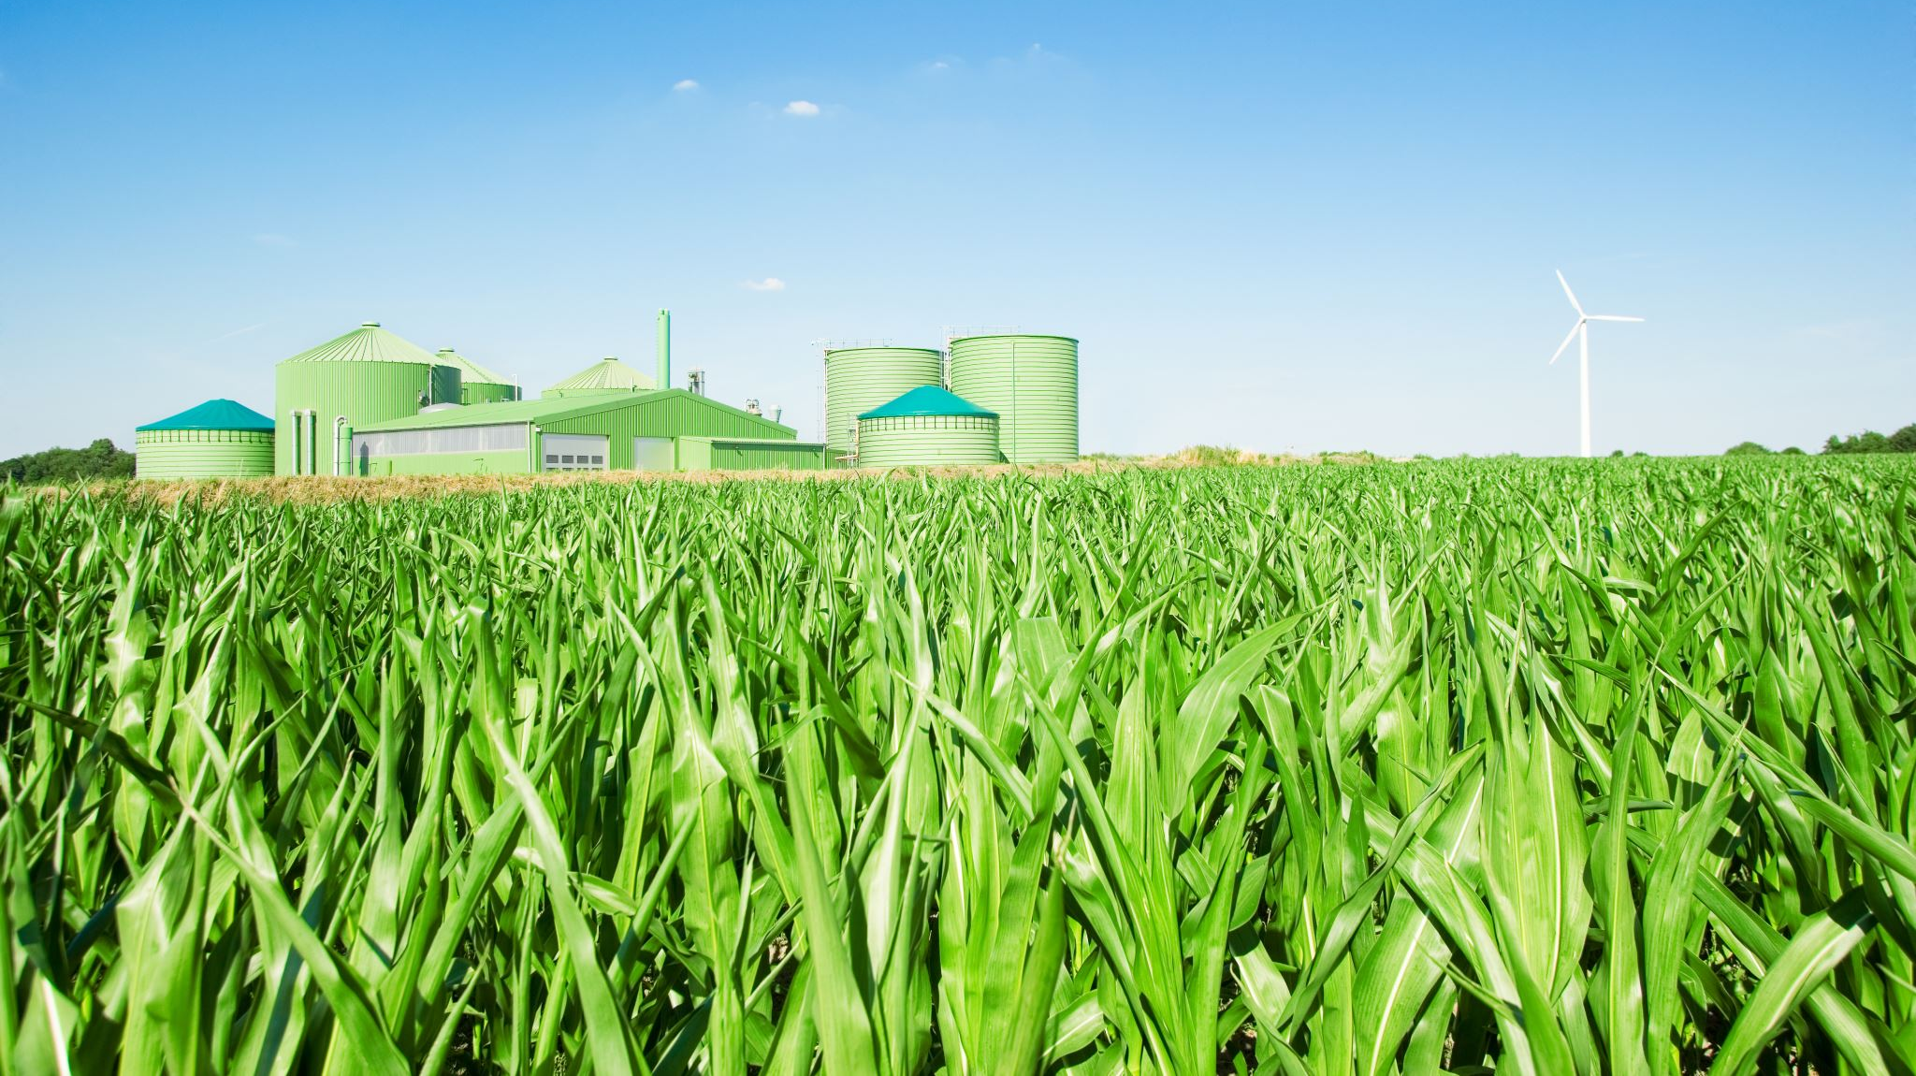

Agricultural & Environmental Benefits:

Slide 11
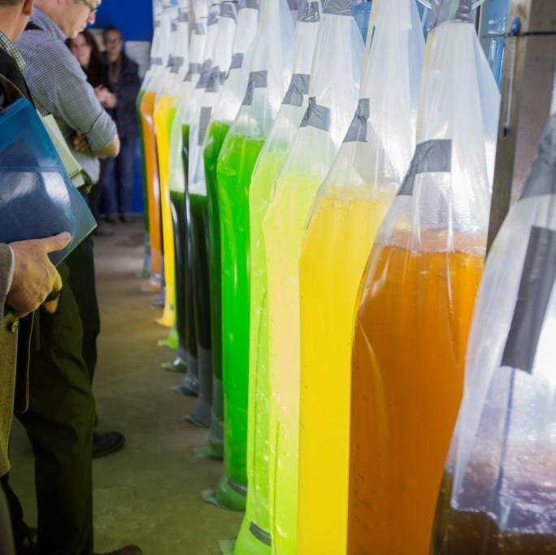


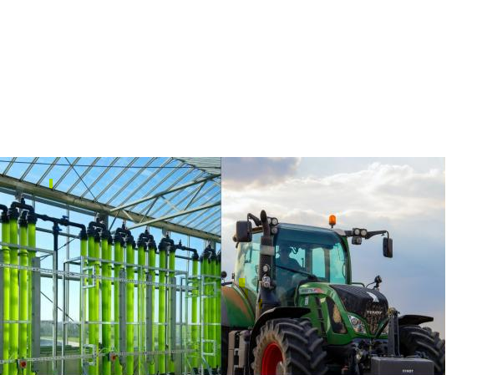


Natural products
Build up on the bioproducts knowledge and past excellence of Phycopigments, Chl-F, EnAlgae and ALG-AD
Biostimulants and biofertilizers
Biopesticides- Volatile compounds for insect attraction
Exopolysaccharides, pigments
Anticancer, anti-obesity
Antioxidants, vitamins, enzymes
FOOD SECURITY
APPLICATION
Crop
Pharmaceuticals
Cosmeceutical
Pest control
Algal biomass production
Biofertilizers, biostimulants for crops
Animal feed
IMPACT
Remediation of agriculture waste
Environmental
Academia
Business
Governmental
Food security
Insects control

Slide 12








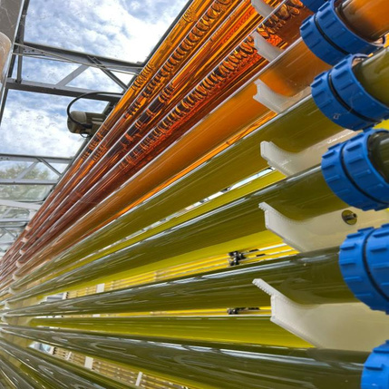




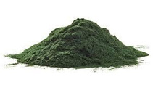








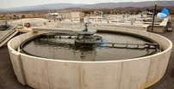

ALG-CO₂ and IAA
Fishmeal
(made from wild-caught
CO2
fish)
Fish feed
Aquaculture
Brewery Wastewater
Microalgae
Microalgae
biomass
Farm
Clean Water
Biofertiliser
Wastewater treatment plant
Mineral fertiliser

Slide 13
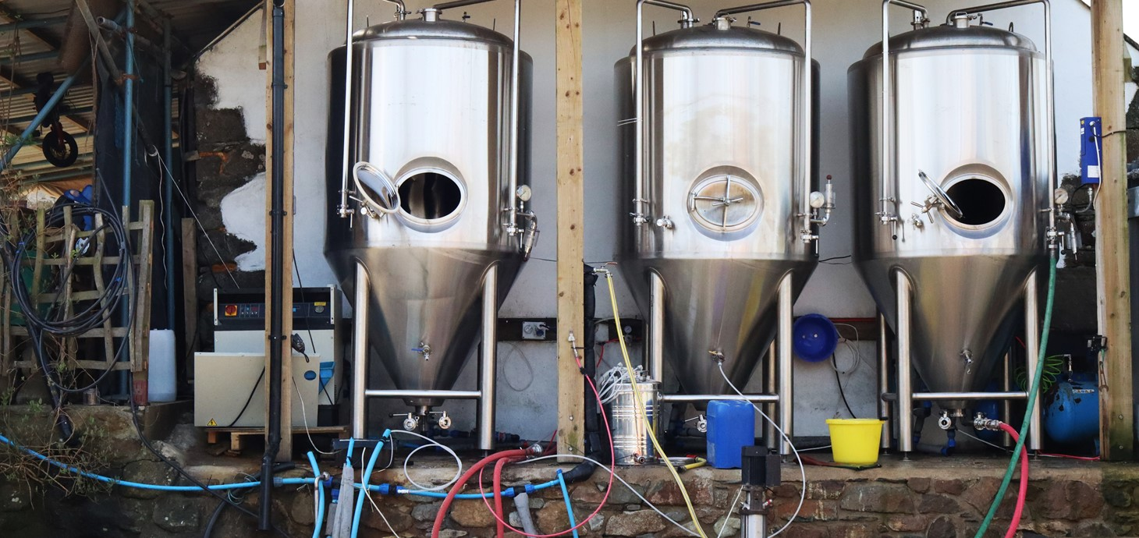
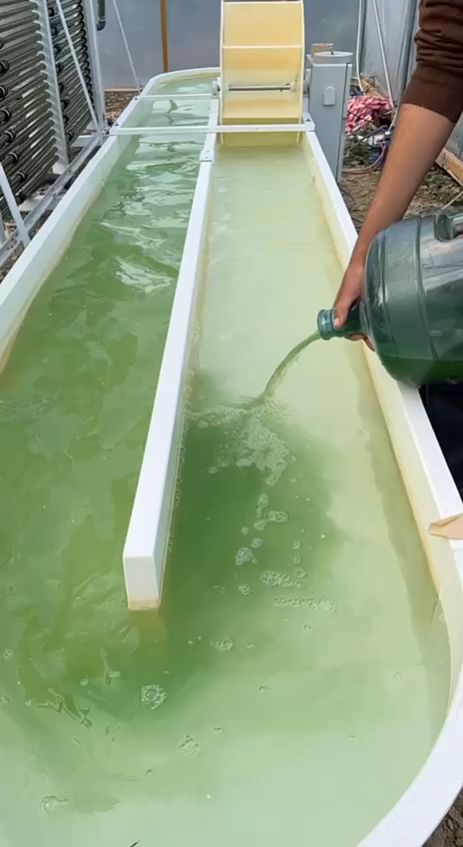
Overview of the Algar Brew and ALG-CO2 project
AIM: reduce CO₂ emissions
Sustainable and circular economy approaches to an industrial level
In the project, Bluestone Brewing is working together with Swansea University (SU) to develop new approaches using cultivation of microalgae with CO₂ emissions,
creating products to help economic growth for local business

Slide 14
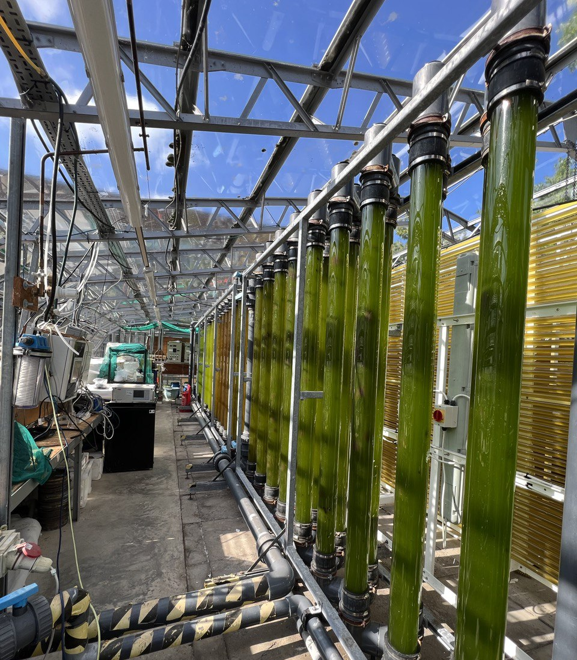
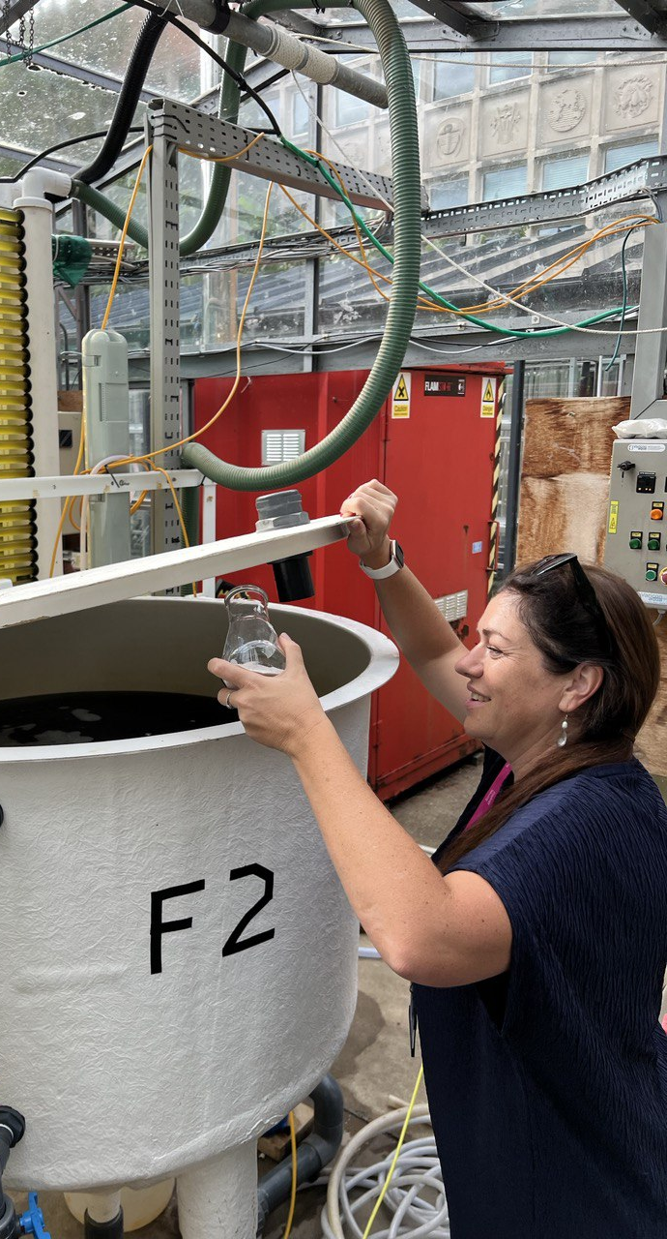
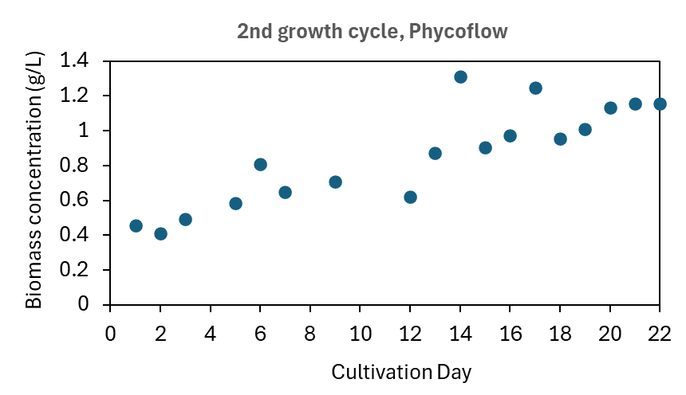
Pilot scale-up
Filtered
Wastewater
1,000 L
with 102mg/L of NO3 and ~50 mg/L of PO4
Seawater
Nannochloropsis culture Regime 2
2 rounds produced 4kg of algae
Harvest
Wastewater + f medium
Wastewater + f medium
Harvest

Slide 15
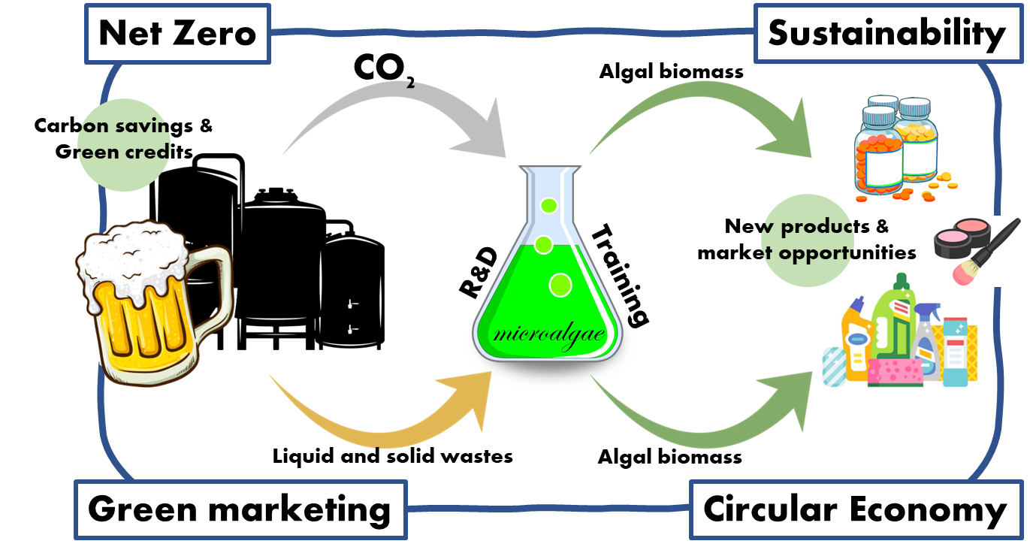
Algal biotechnology green technology application

Slide 16
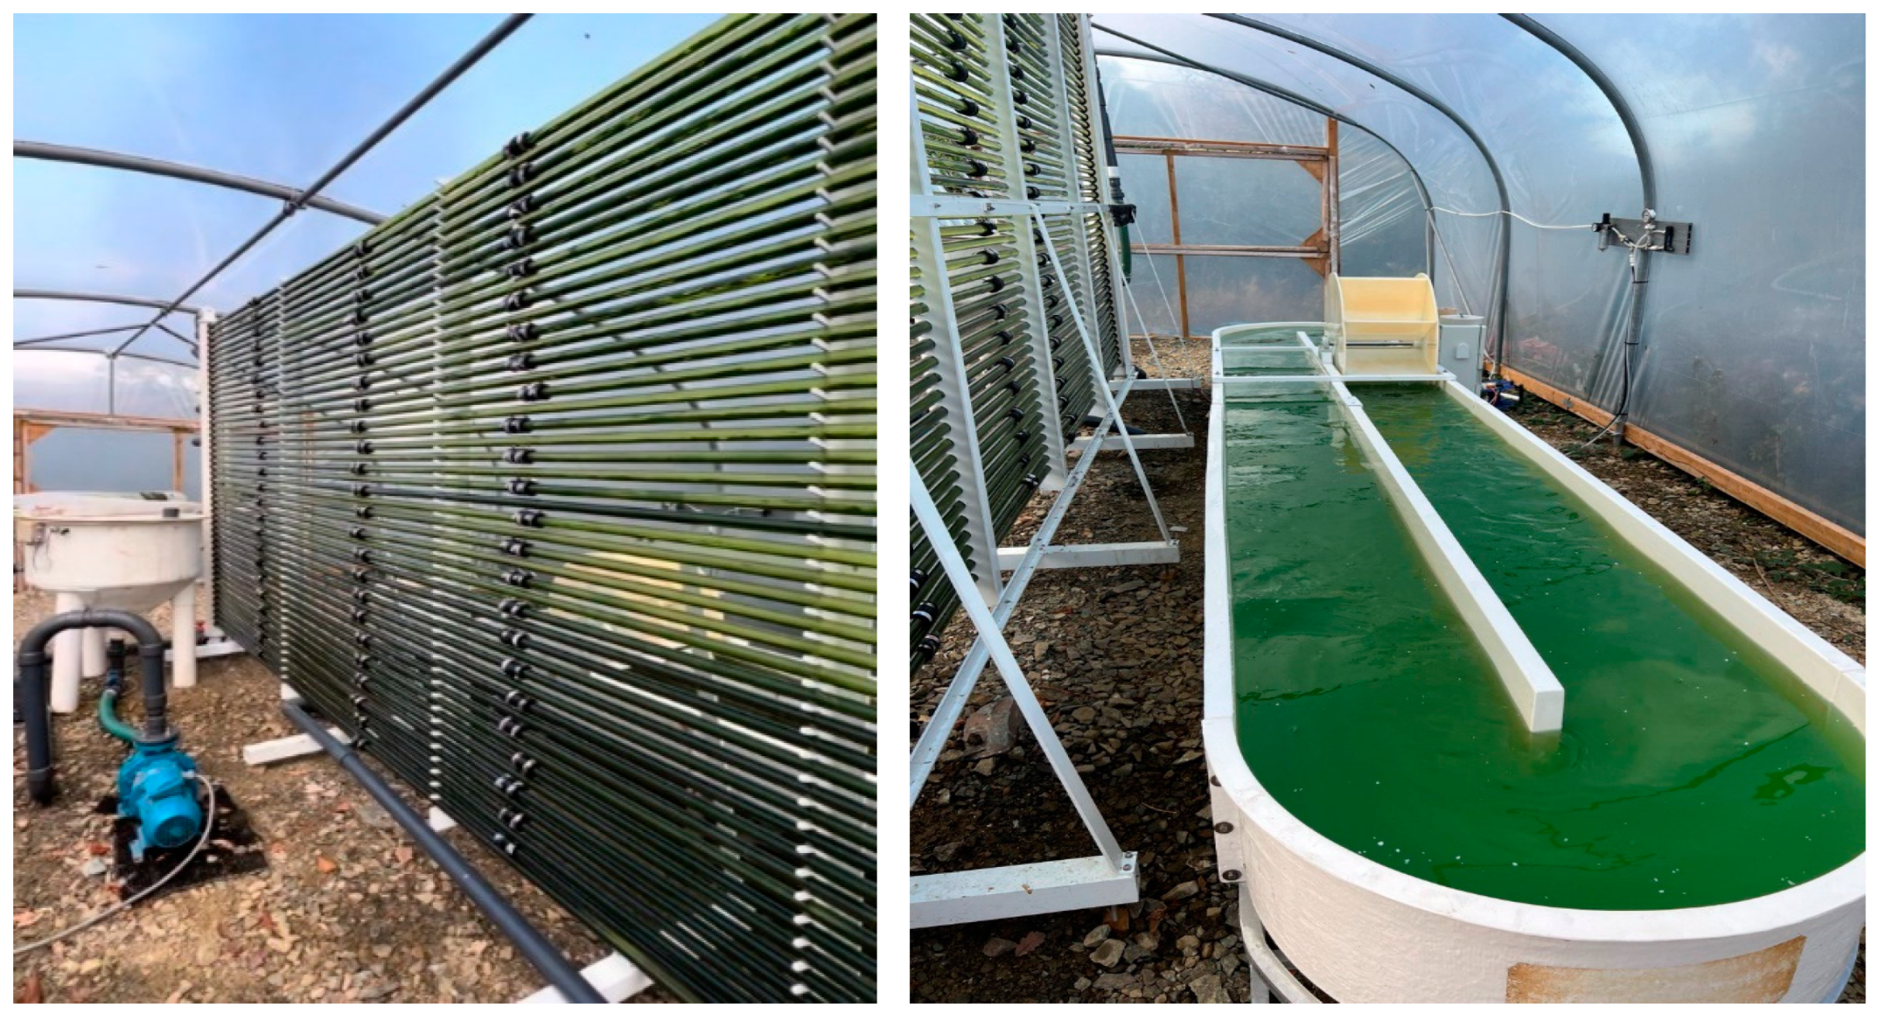
CO₂ from fermentation industry
Cultivation | Total biomass harvest per 300 days (kg) | Total CO₂ removal per 300 days (kg) | Total protein per 300 days (kg) | Total phycocyanin per 300 days (kg)
Spirulina maxima
400L PBR | 96 | 211.2 | 46 | 6.3
1,000L RW | 156 | 343.2 | 84.2 | 10.3
Scenedesmus obliquus
400L PBR | 57.6 | 126.72 | 21.8 | n/a
1,000L RW | 96 | 211.2 | 31.6 | n/a
Horizontal tubular photobioreactor (400 L capacity (left)) and raceway (1000 L capacity (right)) installed inside of a polytunnel. Both systems received CO₂ waste gas from the Bluestone brewery, Pembrokeshire , UK
Silkina, A.et al Energies 2024, 17, 6125. https://doi.org/10.3390/en17236125

Slide 17
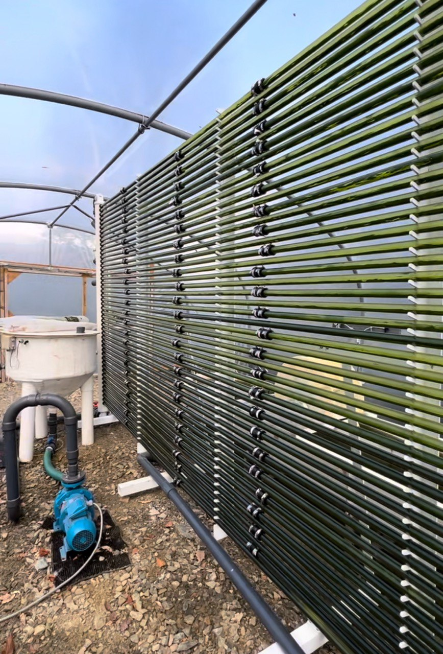
Experimental trials at Brewery location
ReSULTS
Data set of two algal species grown on the CO2 in raceway and PBR
Scientific peer review paper published
Silkina, A.; Emran, M.A.; Turner, S.; Tang, K.W. Using Microalgae to Convert Brewery Carbon Gas Emissions into Valuable Bioproducts. Energies 2024, 17, 6125. https://doi.org/10.3390/en17236125

Slide 18
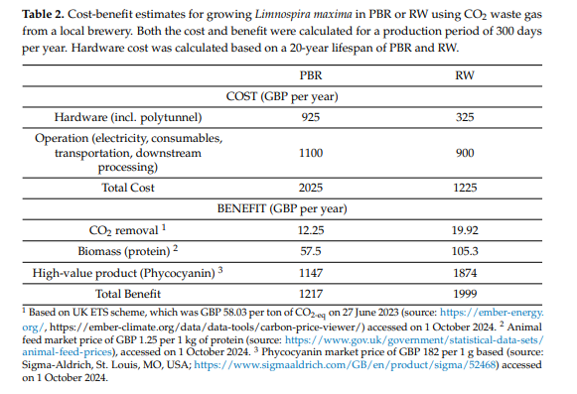
Silkina, A.et al Energies 2024, 17, 6125. https://doi.org/10.3390/en17236125

Slide 19
Trails in 2024 at Bluestone brewery location
From April till October 2024 and re start March 2025
2 harvestings
Biomass collection and preservation
Data on analysis of CO₂ concentration :

Slide 20
Take-home message
Innovative GREEN Applications of algal biotechnology :
🌱 Agro-biostimulants & Biofertilizers
Boost plant growth and soil health, reducing agrochemical dependency.
🌍 Carbon Capture & Circular Economy
Converts waste CO₂ from industrial emissions into valuable algal biomass.
Supports low-carbon agriculture.
💧 Waste Nutrient Remediation
Algae treat wastewater by removing nitrogen and phosphorus.
Prevents eutrophication and recovers nutrients for reuse.
💊 Nutraceuticals
Rich in omega-3s, antioxidants—ideal for functional foods and health supplements.

Slide 21



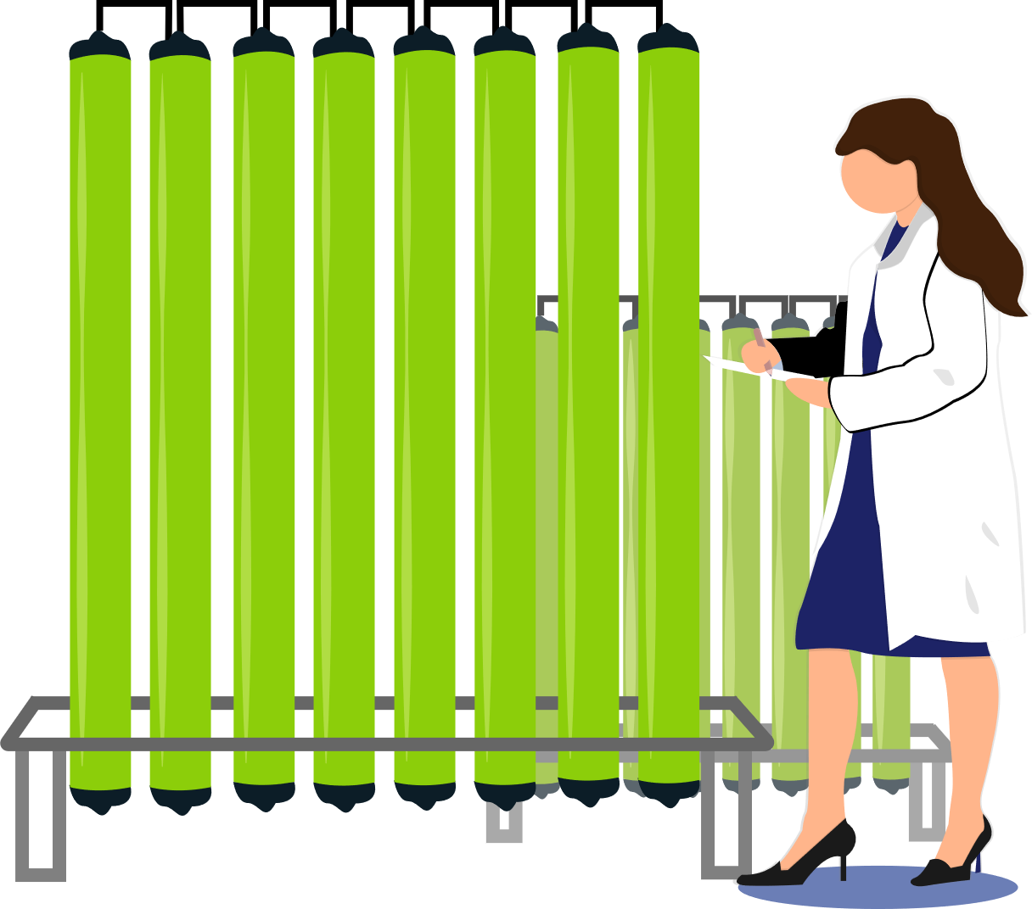
Thank you for your attention
Дякую!
a.silkina@swansea.ac.uk

